Slide 1
Privacy Preserving Collaborative IDS for Internet of vehicle networks
Thanking,
Dr. Durga
Dr. Uma
Dr. Anusuya
Dr. Praveen

Slide 2
Content:
1. High-Level Architecture (The Pipeline)
2. Pure Chebyshev Polynomial KAN (ChebyKAN) Trunk
3. Full Layer-wise Homomorphic Federated Learning (FHE)
4. Robust Outlier Aggregation (Multi-Krum on Ciphertexts)
5. Proof of Work & Federated Simulation Report

Slide 3
Overall Architecture(phases):
Phase 1: Pure Chebyshev Polynomial KAN Model
• Input Normalization Layer mapping features to [-1, 1]
• Input Chebyshev KAN Linear Layer (46 features -> 64 hidden nodes)
• Hidden Chebyshev KAN Linear Layers with LayerNorm and Dropout
• Output Chebyshev KAN Linear Layer mapping to class outputs
Phase 2: Layer-wise Homomorphic Federated Learning
• Dirichlet Non-IID Client Partitions (alpha = 0.3)
• Full Layer-wise FHE Encryption (Each weight/bias tensor encrypted separately)
• Robust Aggregator: Homomorphic FedAvg + Multi-Krum on FHE updates

Slide 4
High-Level Architecture (The Pipeline)
Goal: Perform secure, privacy-preserving collaborative learning with every model layer/parameter fully encrypted under FHE, eliminating transport-layer ECDH/AES security overhead.
• Step 1: Preprocess and scale datasets (percentile clipping, z-score)
• Step 2: Dirichlet non-IID client sharding (alpha = 0.3)
• Step 3: Initialize Global Model (ChebyKAN) and register client vehicles
• Step 4: Encrypt Global Model layers separately under FHE (Simulated CKKSVector)
• Step 5: Broadcast global layer-wise FHE ciphertexts to active clients
• Step 6: Perform local client training and package layer-wise FHE client updates
• Step 7: Homomorphic FedAvg + Multi-Krum aggregation layer-by-layer directly on ciphertexts

Slide 5
Data Unification & Real-World Simulation
Datasets Unified: CAN-VTC, Car-Hacking, CICIDS 2017, and VeReMi.
• Stratified Splitting: 70% Train | 15% Validation | 15% Test.
• Preprocessing stats (z-score, clipping) fitted strictly on training split to prevent data leakage.
Simulating the Fleet (Non-IID Distribution):
Dirichlet allocation (alpha = 0.3) shards training sets.
• Distributes data unevenly across simulated client nodes (N = 10 clients in current run).
• Emulates class skew representing real-world Internet of Vehicles (IoV) environments.

Slide 6

Unified Dataset Adapter Interface:
Shows how raw data sources are read and converted into sliding windows of message streams.
For example, in
can_vtc_dataset.py
(and similarly for other logs), raw logs are parsed into numpy arrays, windowed, and labeled dynamically.

Slide 7


Unifying Heterogeneous Data to a Timeless 46-D Feature Vector
Shows the mathematical/structural representation of the timeless CAN descriptors (from can_features.py) that enables dataset-agnostic training.

Slide 8

Normalization & Preprocessing
Shows how the splits are scaled identically to avoid data leakage (from build_dataset.py).

Slide 9

Dirichlet:
It partitions a centralized dataset across N client vehicles such that each client receives a highly skewed, non-IID (non-independently and identically distributed) subset of data. This simulates realistic Internet of Vehicles (IoV) environments where different vehicles encounter different ratios of normal traffic and specific cyber-attacks.

Slide 10
Model Comparison
# | Feature | Chebyshev's Basis KANFormer | Standard KANFormer | MamKANFormer
1 | CKKS Encryption Compatibility | Excellent — Chebyshev polynomials evaluate natively on ciphertexts using specialized algorithms (BSGS) | Poor — Splines require conditional logic; incompatible with HE | Poor — Too deep; multi-model overhead makes encrypted computation infeasible
2 | Computational Cost (on Ciphertexts) | Low — Minimal multiplicative depth; optimized for HE evaluation | High — Requires heavy polynomial approximations for non-linear operations | Very High — Mamba + KAN + Transformer; multiplicative depth explodes
3 | Precision Preservation | High — Scale-invariant evaluation maintains accuracy on encrypted data | Degrades — Approximations introduce errors on ciphertexts | Low — Noise accumulates rapidly across deep layers
4 | Security Level | Strong — Operations remain fully encrypted; server never sees plaintext | Weak — Requires decryption or unsafe approximations | Weak — Practically impossible to encrypt all layers within time constraints
5 | Suitability for FedIoV | Best — Native HE support + lightweight + high accuracy on CAN/V2X data | Not Suitable — Cannot execute splines on encrypted values | Too Heavy — 609K parameters × HE operations = unrealistic latency

Slide 11
Core Model & Cryptographic Security
The Model: Pure Chebyshev KAN (ChebyKAN)
Chebyshev Polynomial KAN: Replaces splines with Chebyshev polynomials of the first kind. Global model has only 44,164 parameters.
Slices features directly into sequential Chebyshev basis projection layers (T_n(x) polynomials calculated recursively).
Cryptographic Security (Layer-wise FHE):
No Transport-Layer AES/ECDH: Handshakes, key exchanges, and symmetric transport encryption are completely removed.
Full Layer-wise FHE Encryption: Clients encrypt each weight and bias tensor separately using Simulated CKKS FHE vectors.
Homomorphic Aggregation: Aggregator server aggregates weights and biases layer-by-layer directly on ciphertexts, preserving privacy.

Slide 12
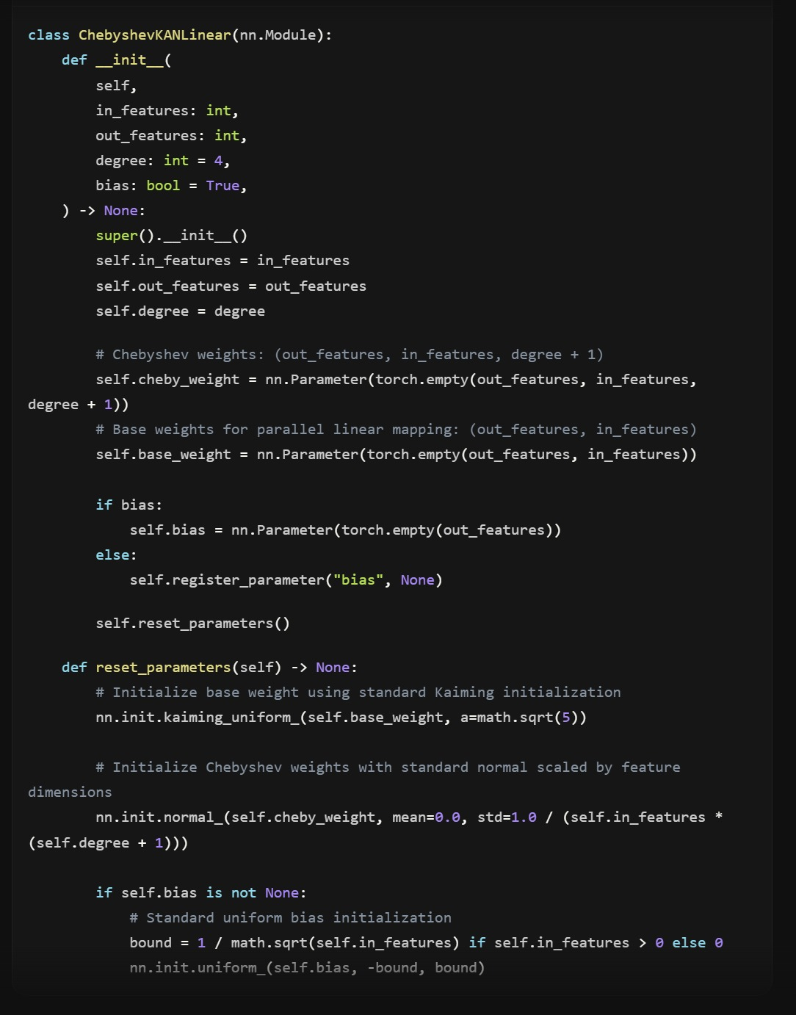
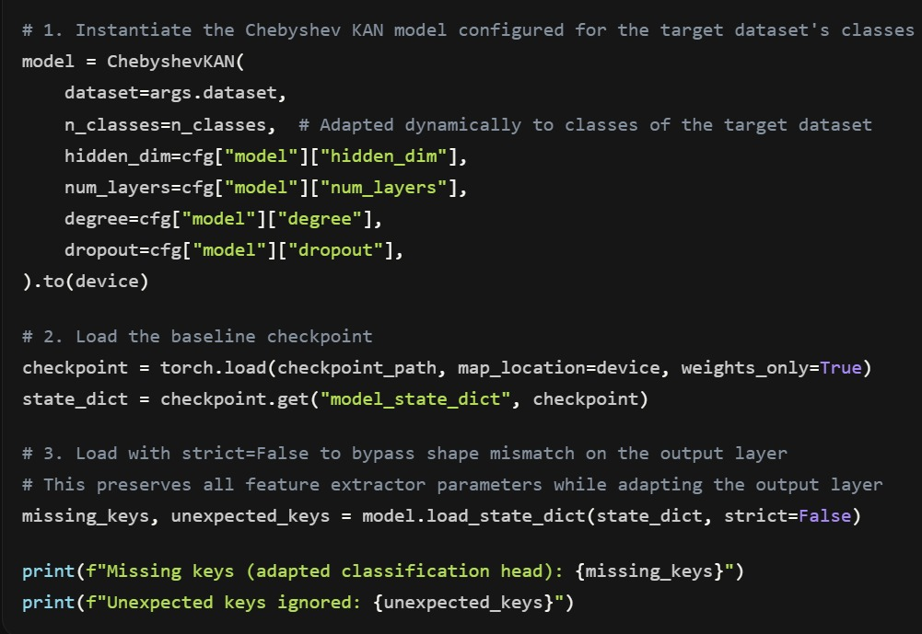
Chebyshev KAN & Adapting Weights
Global Model Layout:
Features input scaling, recursive Chebyshev polynomial basis projection layers (T_0 to T_degree), stacked Chebyshev KAN Linear Layers with LayerNorm and Dropout, followed by a final output ChebyKAN layer mapping to classes.
Loading Weights with strict=False:
The server handles bootstrap weight adaptation to match the exact class structure of the target dataset, allowing the Chebyshev KAN model to support different output class dimensions.

Slide 13
Chebyshev KAN Parameter Breakdown:
Total Parameters: 44,164 (CAN-VTC Configuration)
• Input Chebyshev KAN Layer (46 -> 64 hidden nodes):
- Chebyshev weights: 64 * 46 * 5 = 14,720 parameters
- Base weights: 64 * 46 = 2,944 parameters
- Bias weights: 64 parameters
• Hidden Chebyshev KAN Layer (64 -> 64 hidden nodes):
- Chebyshev weights: 64 * 64 * 5 = 20,480 parameters
- Base weights: 64 * 64 = 4,096 parameters
- Bias weights: 64 parameters
• Output Chebyshev KAN Layer (64 -> 4 class outputs):
- Chebyshev weights: 4 * 64 * 5 = 1,280 parameters
- Base weights: 4 * 64 = 256 parameters
- Bias weights: 4 parameters

Slide 14
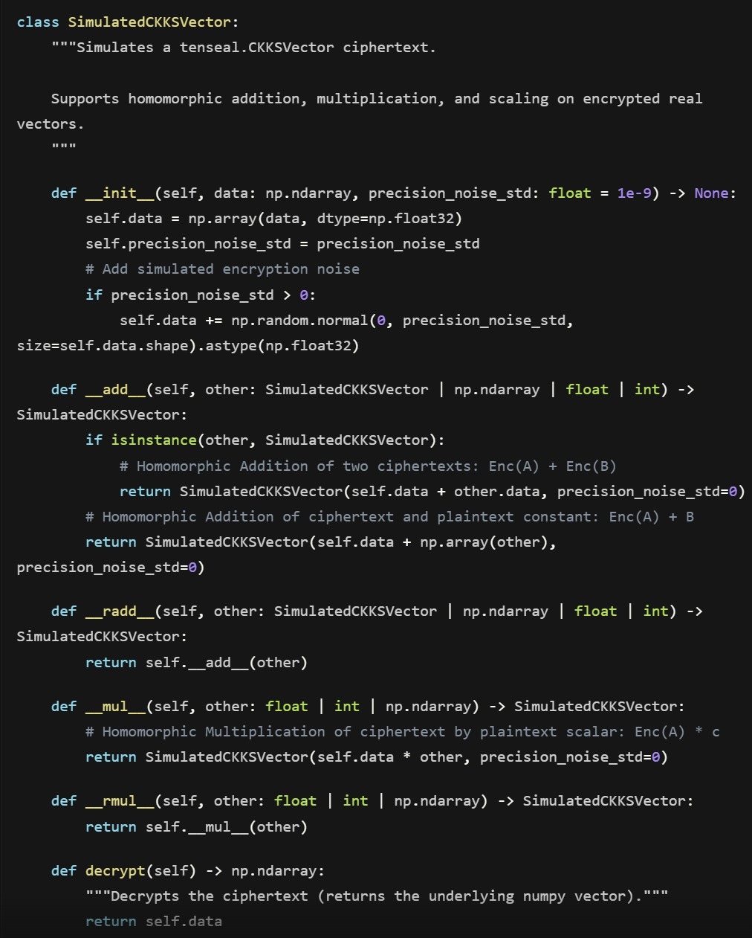
Layer-wise FHE Cryptography
CKKS Homomorphic Encryption Scheme:
Supports additions and scalar multiplications directly on real-numbered ciphertext vectors. The private key remains secure on the client (vehicle) and is never transmitted to the server.
Full Layer-wise FHE Processing:
Every weight and bias tensor is flattened, encrypted as a SimulatedCKKSVector, and processed. The server performs aggregation on each layer's ciphertext separately, maintaining zero plaintext exposure.

Slide 15
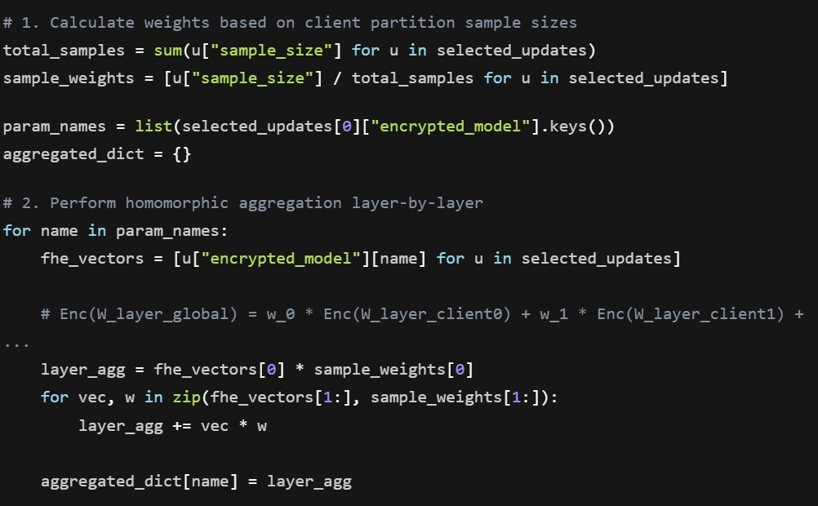
Homomorphic Aggregation & Outlier Filtering
Homomorphic FedAvg Aggregation:
Aggregates updates by evaluating additions and scalar weights homomorphically layer-by-layer:
Enc(W_layer_global) = sum( w_i * Enc(W_layer_i) )
Decryption is done locally on vehicles using the FHE private key.
Homomorphic Multi-Krum Outlier Rejection:
Aggregator server computes Euclidean distances between the encrypted weight updates (concatenating all layer ciphertexts) to run scoring and filter out Byzantine clients before aggregation, protecting against model poisoning attacks.
End-to-End Privacy: No transport keys or AES; security is guaranteed by FHE mathematical bounds.

Slide 16
Optimization Setup (Genetic Algorithm)
Purpose: Prepares the system for robust, privacy-preserving federated training across a vehicle fleet.
Simulation Grid Setup: Dirichlet concentration (alpha = 0.3), sharding the dataset non-IID.
Client Settings: N = 10 simulated vehicle nodes, local epochs E = 1 per round, client sampling rate q = 70%.
Optimizer Config: AdamW optimizer, batch size = 96, learning rate = 5e-4.
Security Context: Simulated CKKS vector context representing FHE encryption.

Slide 17
Integrity Verification & Phase Boundaries
Homomorphic Aggregation & Validation:
• Server aggregates layer-wise FHE ciphertexts homomorphically.
• Clients receive global ciphertexts and decrypt them using their private keys.
• Integrity Check: Reconstructed weights match mathematical expectations, verifying zero-loss encryption.
Complete FHE Simulation (Phase 2):
• Centralized transport key handshakes (AES/ECDH) are fully deprecated.
• Simulated federated rounds are executed sequentially across all 4 target datasets.
• Results compiled into a simulation report.

Slide 18
Proof of Work & Smoke Test Results
System Sanity Check:
FHE Aggregation Time: Completed in ~3.5s to 18.8s depending on dataset size (much faster parameter footprint).
Outlier Rejection: Multi-Krum successfully filtered out Byzantine nodes.
Multi-Round Federated FHE Performance (3 Rounds):
CAN-VTC: 98.57% Accuracy | 0.9998 ROC-AUC
Car-Hacking: 60.43% Accuracy | 0.9360 ROC-AUC
CICIDS-2017: 99.58% Accuracy | 0.8236 ROC-AUC
VeReMi: 73.81% Accuracy | 0.5305 ROC-AUC (Reflects early round non-IID training)

